Slide 1
Agenda
Pair Programming
Driver, Navigator, Reviewer Role (Teams of 3)
Reviewer Guidelines
Milestone Reports
Source Control Overview
Project Repo Setup Guide
TA Meetings

Slide 2
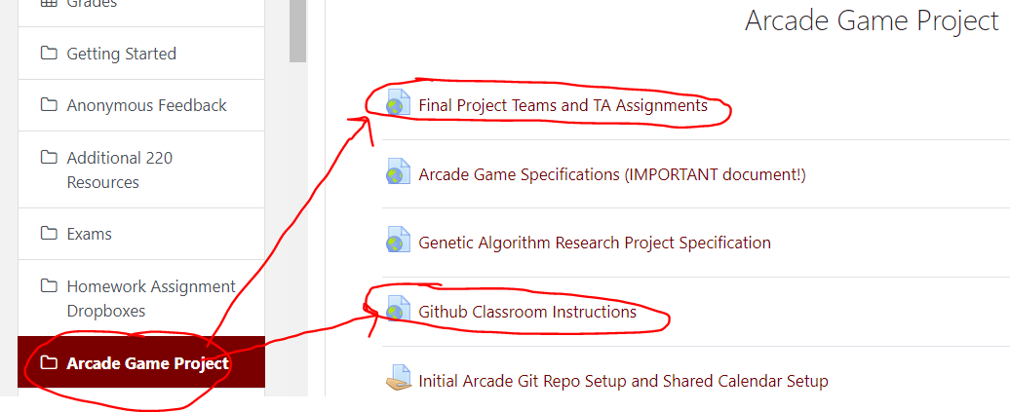
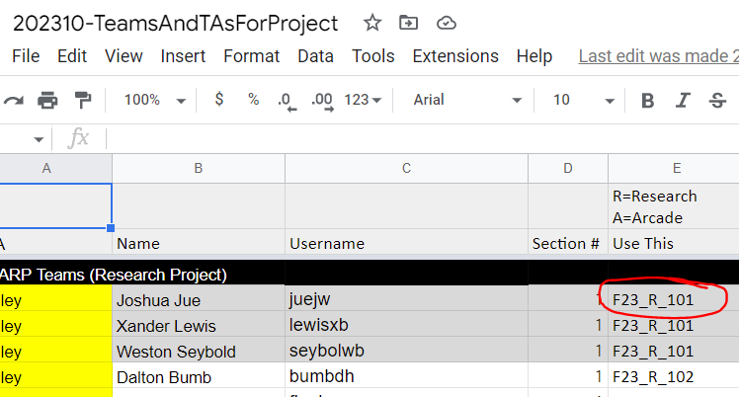

Practice
With your team, follow the instructions to get your repo setup
You will submit your Final Project from your repo

Slide 3
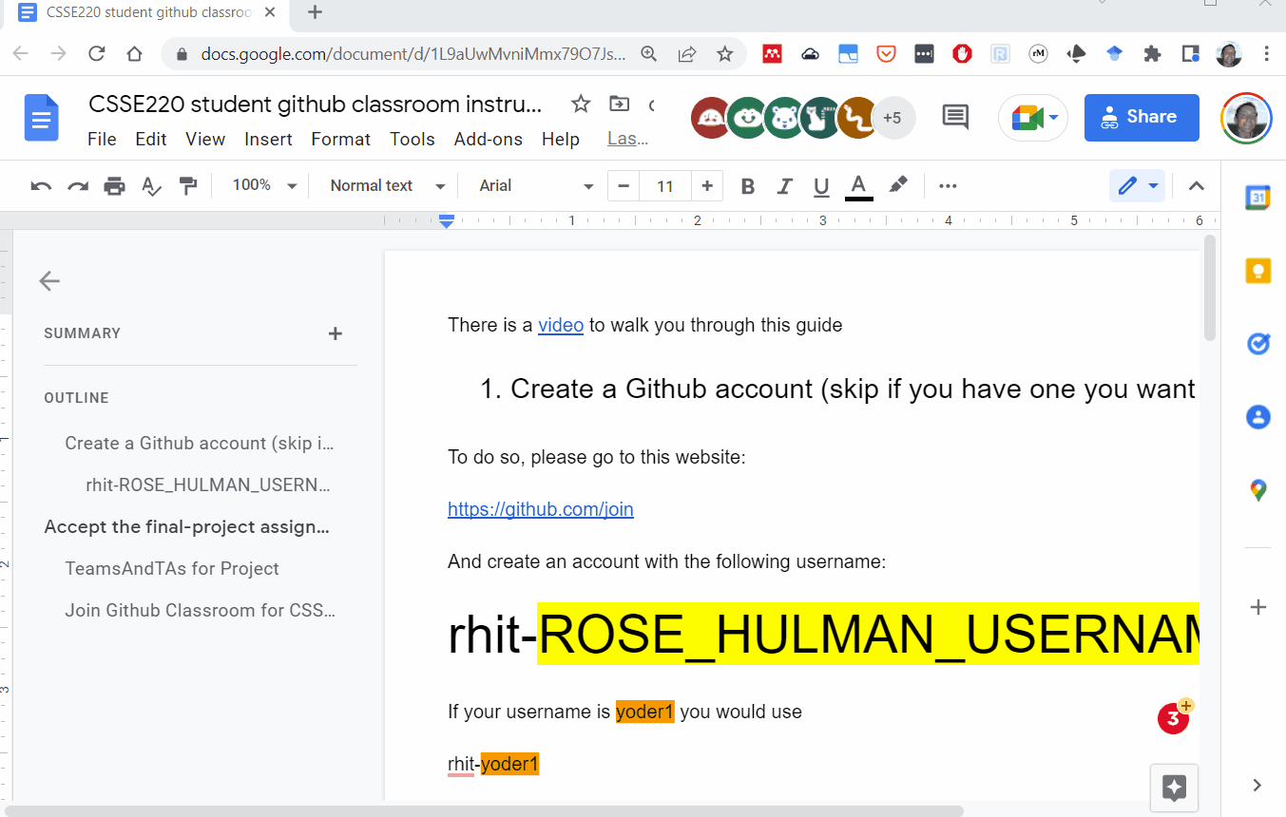

Slide 4
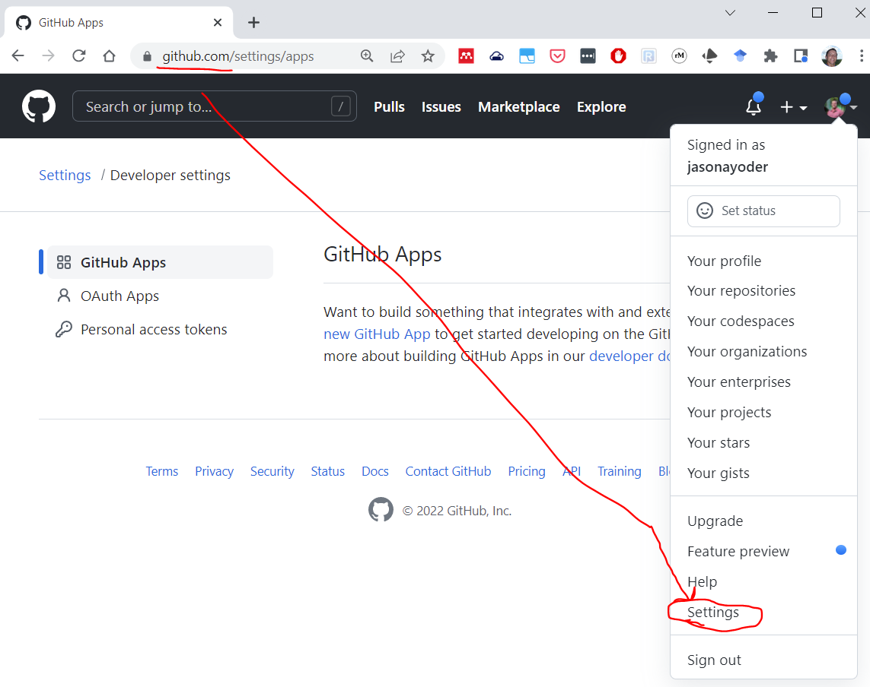
#1
Sign into
GitHub.com
Go to your account (upper right) and then select Settings

Slide 5
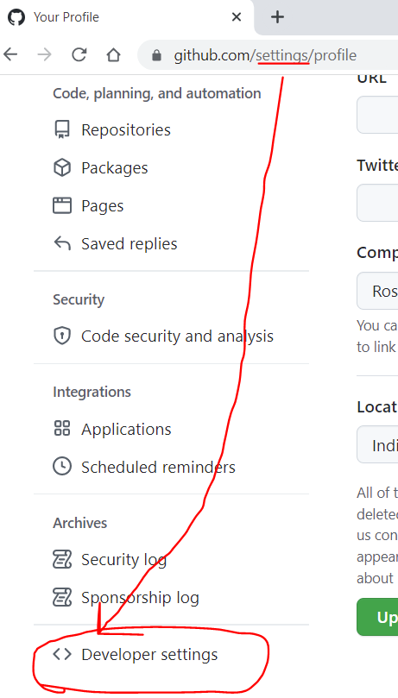
#2
Scroll to the bottom of the settings page and select:
“Developer settings”

Slide 6
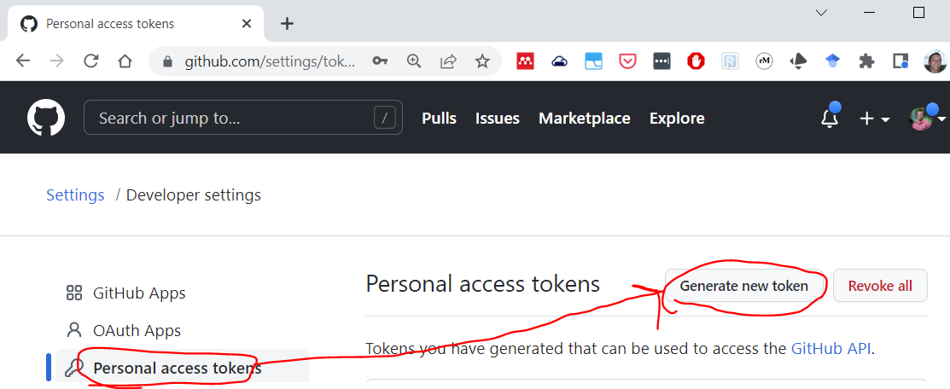
#3
Go to Personal access tokens and select “Generate new token” and give yourself enough time to finish the course. (You can always generate more tokens later)
GitHub will only show you this token ONCE so you need to save it to be able to use it.
You can select the “Store in Secure Store” in Eclipse to be able to re-use it over and over again

Slide 7
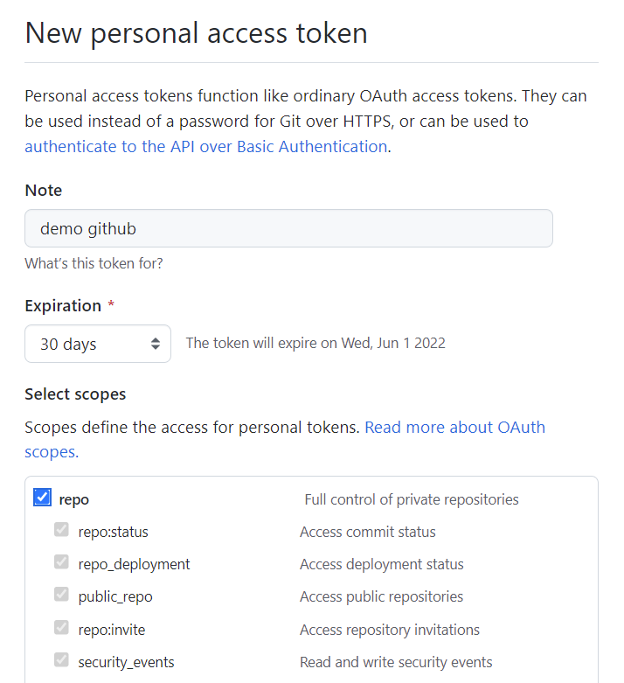
#4
GitHub will only show you this token ONCE so you need to save it to be able to use it.
You can select the “Store in Secure Store” in Eclipse to be able to re-use it over and over again

Slide 8
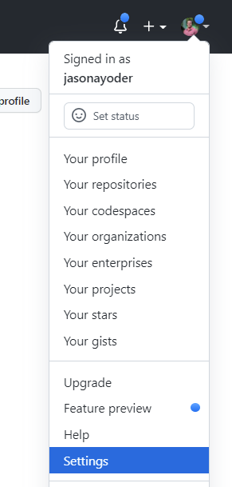
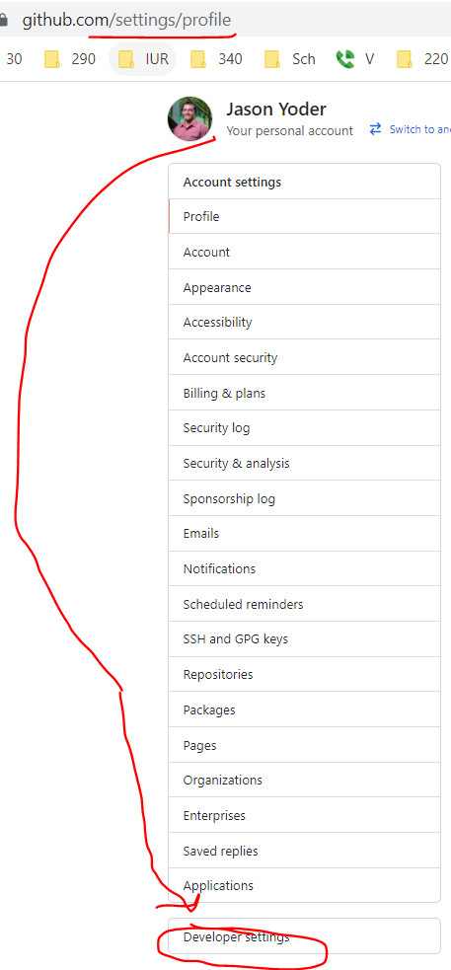
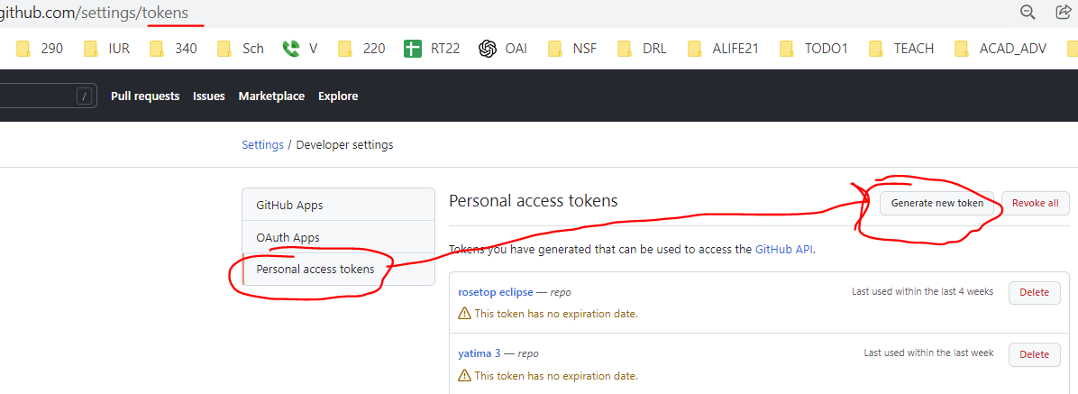
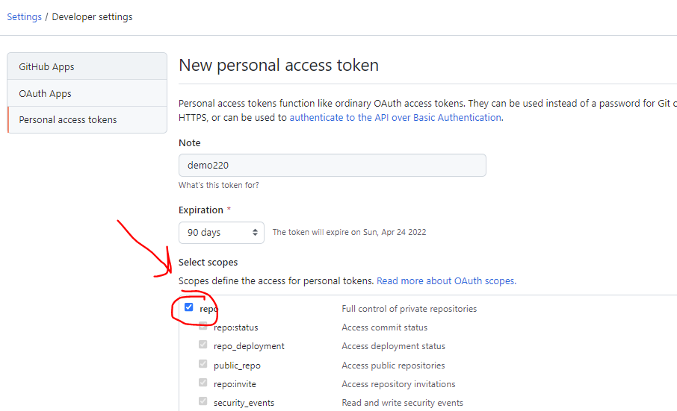
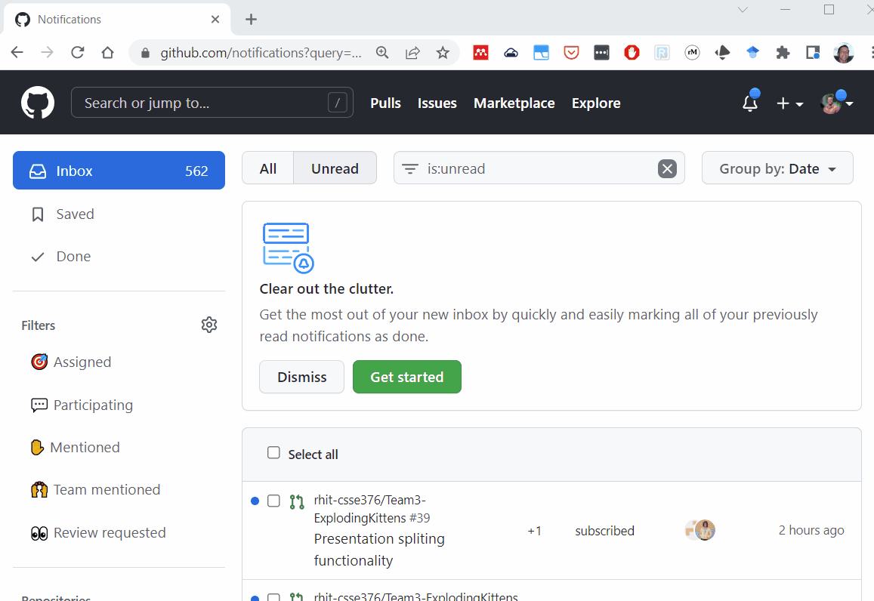
#2
#3
#1
#4

Slide 9
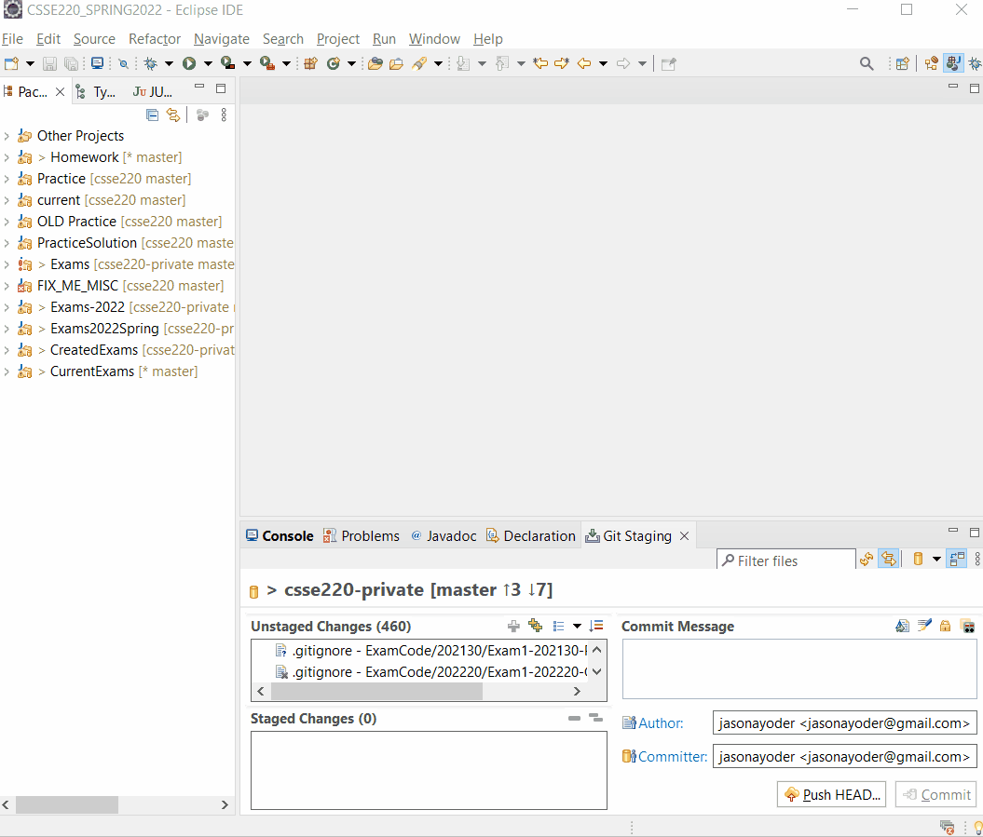
You have to use your Personal Access Token AS your password The username is your GITHUB username
#5

